Slide 1
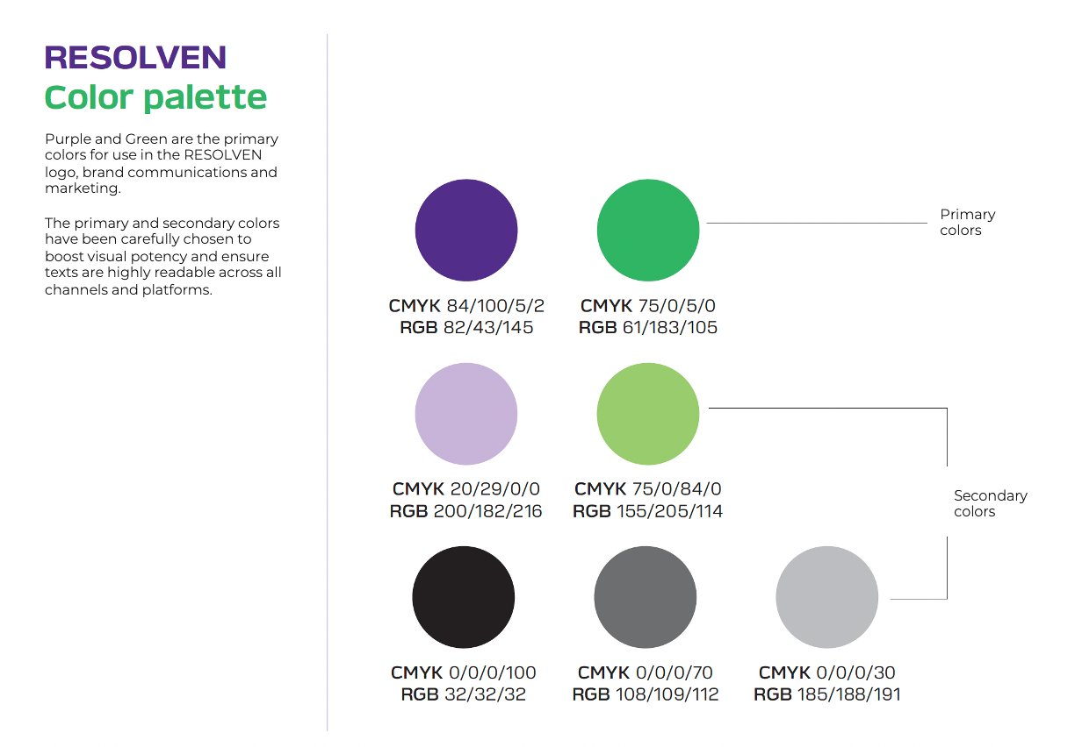

Slide 2
INSTRUCTIONS & GUIDELINES
All title typeface – VERBATIM WIDE BOLD OBLIQUE with one selected word in Green (#3DB769)
There are two types of title slides – one with a title and one without (to be used as required)
All text apart from the title – VERBATIM LIGHT or VERBATIM MEDIUM as per usage
All images/ icons to be used in the diagonal shape
Use the four primary colors and colors closer to the same for graphs and charts and other visual elements.. DO NOT USE ANY OTHER COLORS FROM OUTSIDE THE RESOLVEN FAMILY OF COLORS.

Slide 4
TYPEFACE: VERBATIM WIDE BOLD OBLIQUE
POINT SIZE: 24

Slide 5
Tittle of the slide
TYPEFACE: VERBATIM WIDE BOLD OBLIQUE
POINT SIZE: 36
This is just dummy text. This is just dummy text. This is just dummy text. This is just dummy text.
This is just dummy text. This is just dummy text. This is just dummy text. This is just dummy text.
TYPEFACE: VERBATIM LIGHT
POINT SIZE: 24 (Maximum point size)

Slide 6
Title of the slide

Slide 7
Tittle of the slide
This is just dummy text. This is just dummy text. This is just dummy text. This is just dummy text.
This is just dummy text. This is just dummy text. This is just dummy text. This is just dummy text.

Slide 11
Chart title

